Slide 1
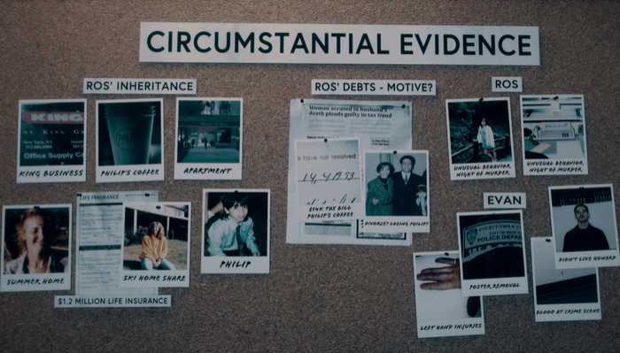
Homicide

Slide 2
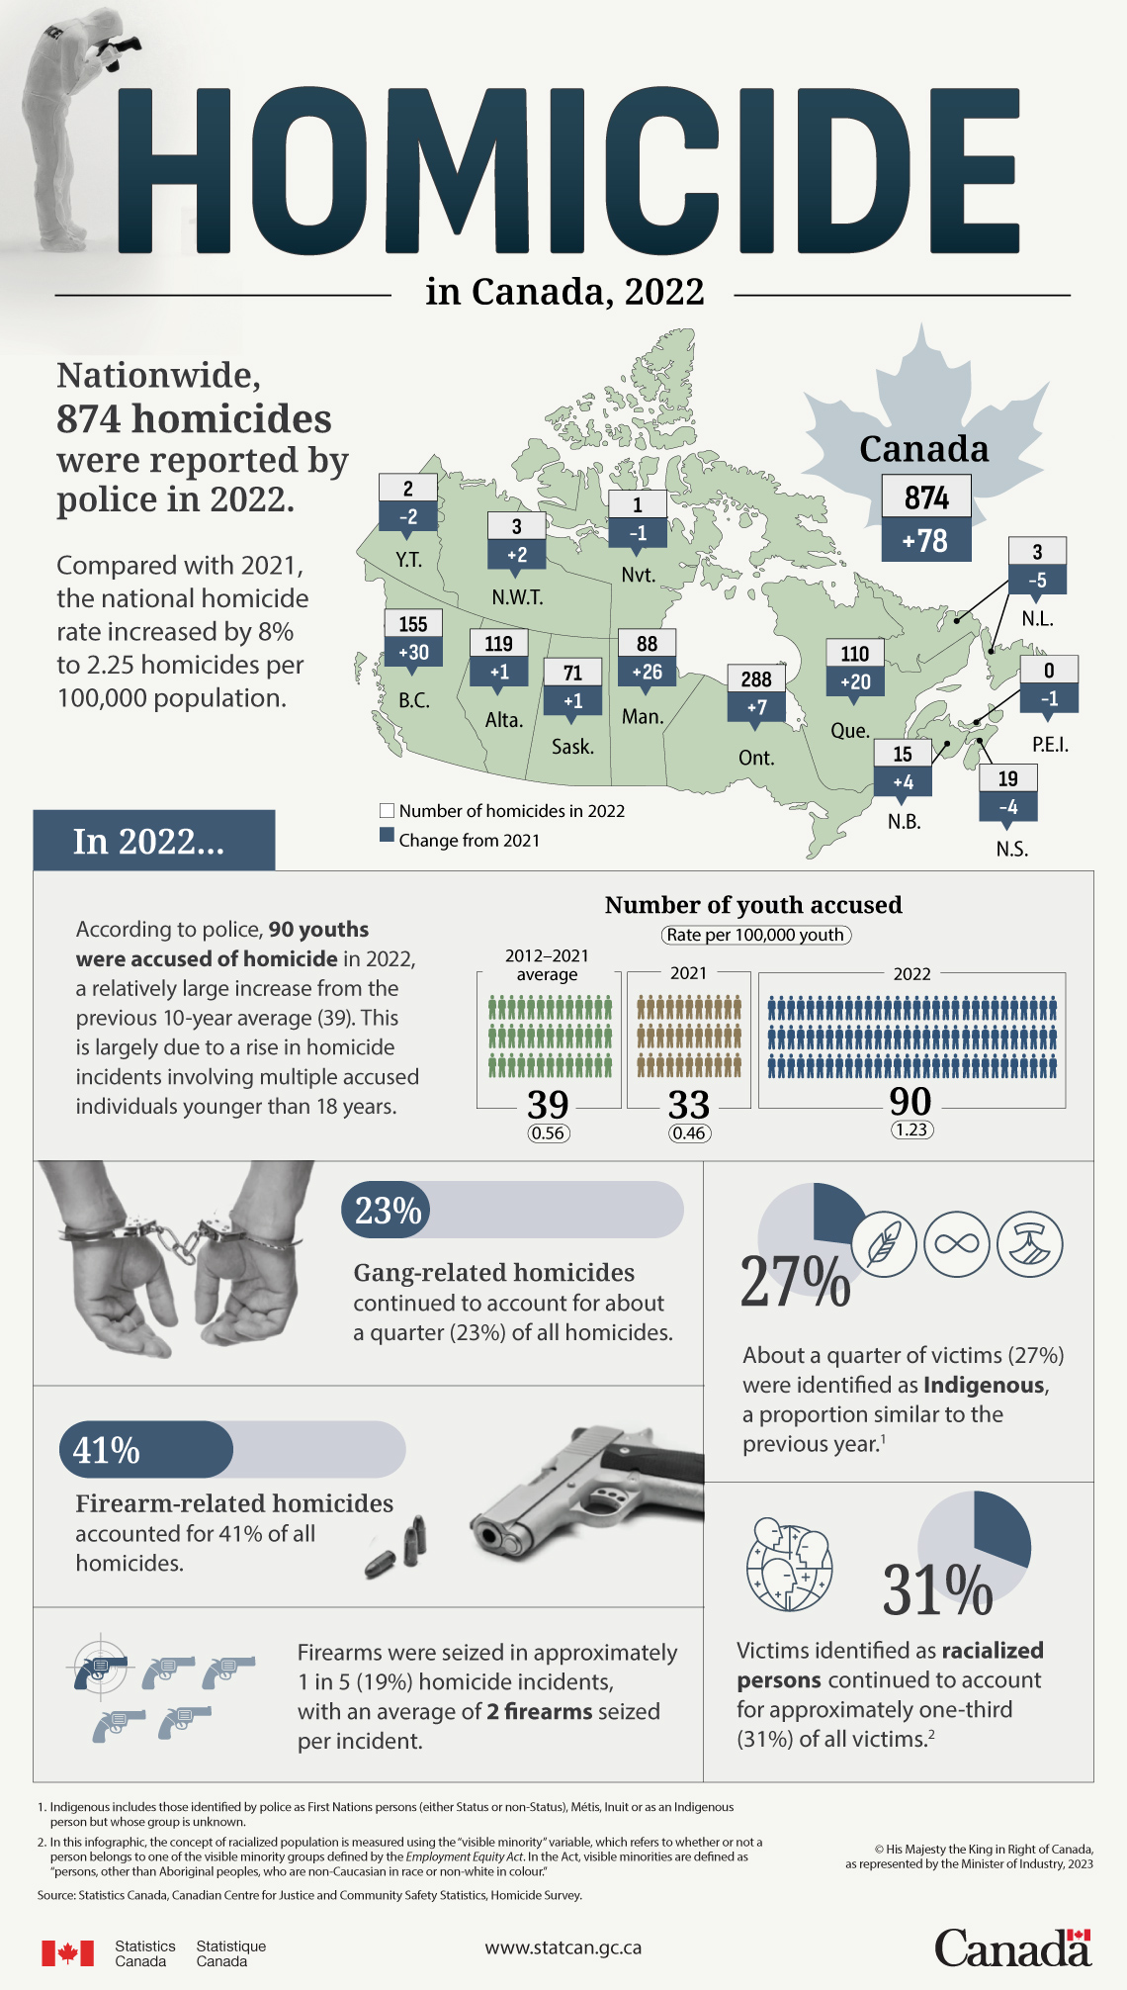

Slide 3
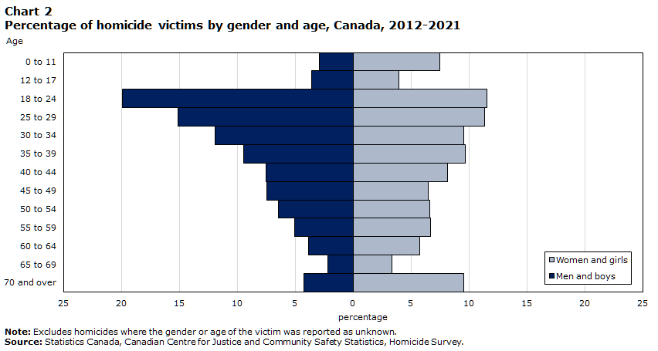

Slide 4
Homicide overview con’td
In 2021, the proportion of women who were killed by their spouse or intimate partner in Canada (“femicide”) was approximately seven times greater than for men. Among spousal and intimate partner homicide victims in Canada, 76% were women while 24% were men.

Slide 5
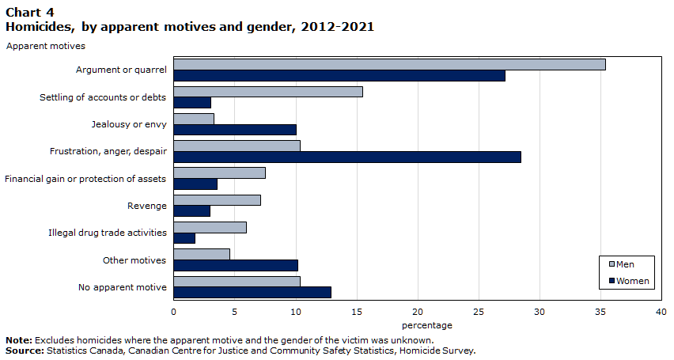

Slide 6
Self-solvers versus ‘whodunnits’
Data between 2017 and 2021 shows that among the most common method used to commit a homicide, shootings take the longest to solve.
While 47% of homicides by shooting were solved within the first 100 days of the investigation, 70% of homicides by beating and 84% of homicides by stabbing were solved during the same amount of time.
Keep in mind: gang-related homicides continued to account for nearly one-quarter (23%) of all homicides – often more difficult to solve.

Slide 7
Homicide disproportionately affects some communities more than others (Canada)
The homicide rate for Indigenous victims was six times higher than that of non-Indigenous victims in 2021 (9.17 per 100,000 Indigenous people versus 1.55 per 100,000 non-Indigenous people).
In 2021, approximately one-third (32%) of victims were identified by the police as racialized persons, resulting in a homicide rate of 2.51 per 100,000 racialized people.

Slide 8
Homicide survivors: Finding out
“As you might imagine, the news of a loved one’s murder is devastating. Symbolic interactionist Norman Denzin (1990: 104) calls it a “shattering emotional experience,” which “leave[s] indelible marks on human character and human relationships.” These marks are formed as a result of the shocking nature of the news, the violent nature of the death, and sometimes how the survivor learns of the death.”

Slide 9
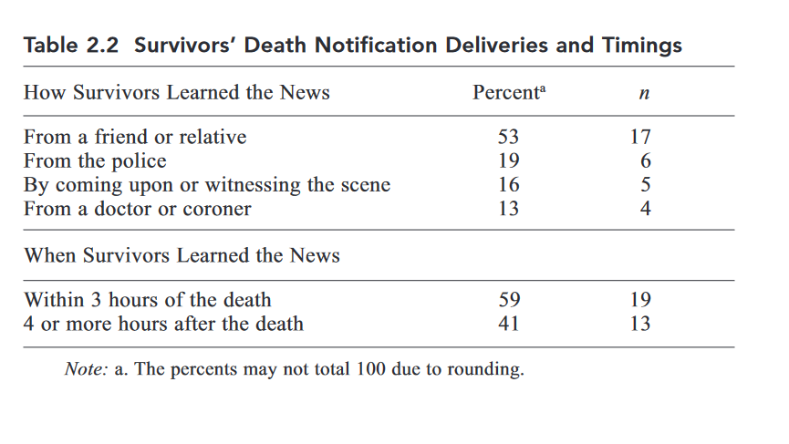
How victims’ families found out (from Sarah Goodrum’s (2020) study of homicide victims)

Slide 10
Death notifications
Victims’ families often find out through a ‘death notification’ – the process whereby police officers notify a victim’s next of kin.

Slide 11
“After Homicide” – Sarah Goodrum (2020)
Andrea described her sleeplessness while waiting for her missing son to come home:
“I couldn’t sleep. My eyes were wide open. Finally, about two o’clock [in the morning] the doorbell rang, and I jumped out of bed. I went to see who it was. There were two men from the Sheriff ’s Office . . . and then there were two ladies dressed in black T-shirts saying “Victim Services.” So, I looked at them, and I said [to myself], “What did my son get into, some kind of trouble or something?””

Slide 12
Common immediate responses to the trauma of losing a loved one to homicide (Rock 1998)
Denial – it must’ve been someone else (Andrea in Goodrum’s study said the body in her car must’ve belonged to a friend of her son’s who had borrowed the car from her son).
Disbelief – it can’t possibly be true
Incomprehension – confused by what one is hearing
A parent of a murdered child: “You go cold, numb, what is being said is heard through a haze”

Slide 13
Long-term responses to the murder of a loved one (Armour 2002)
Feeling betrayed by loved ones and friends – who pretend it didn’t happen, gaslight victims, etc.
Alienation and loneliness – “Homicide rips families away from their loved ones and the community that does not share their grief.” Because homicide is a rare event, most people do not know how to relate to survivors, what to say, how to act.
Lack of closure – there is no new ‘normal’; this is an ongoing psychological trauma that impacts many different aspects of one’s life, including their own feelings of personal safety

Slide 14
Armour’s (2002) study of homicide survivors
Family members waited for the pain to pass, but it never did. A father could not speak his son’s name for 18 years. A mother felt robbed of her son’s future. “I’ll never get over the hopes that we had, that he never got to come home.” A wife said to her husband, “I don’t know if it is ever going to go away or if it is something that I am going to have to live with the rest of my life.” Her husband answered, “I don’t think that it is going to go away.” A mother described her realization that her daughter’s murder would be a permanent nightmare. “[E]very parent has a nightmare where your child dies but you wake up. This was something you cannot wake up from. This was permanent. This is real.”

Slide 15
Problems victims’ families have with ‘the system’ (Goodrum 2020)
sources of conflict in victim-system encounters,
at the murder scene when survivors wanted to see and hold the deceased’s body,
during the investigation when survivors sought to provide and
obtain case information,
(Armour’s 2002 study): ““The information about my dad [who] was killed with 75 wounds and . . . Butchered would probably have been a good thing to tell us
at some point. Rather than finding out at the trial 3 months later.”
in encounters with counselors when survivors disliked their offers of emotional support
(Armour’s 2002 study): A Chaplain providing the death notification lectured the family on forgiveness

Slide 16
victims’ expectations for workers and the case
homicide survivors expected an emotional and legal ally in the detectives and prosecutors handling their loved one’s case, but not in the counselors.
For survivors, an emotional connection with detectives and prosecutors signaled a personal attachment to the case
(in policing, this is a form of ‘emotional labour’)

Slide 17
workers’ sensitivity to survivors’ needs in light of system constraints.
detectives, prosecutors, counselors, and advocates expressed genuine concern for homicide survivors’ long and difficult road to recovery, desire for detailed information about the murder, and demand for a trial in the case.
Yet they struggled to find the balance between what victims wanted and what their jobs and the law allowed. Some homicide survivors’ requests interfered with criminal justice system goals (e.g., strong investigation, preservation of crime scene evidence, conviction)

Slide 18
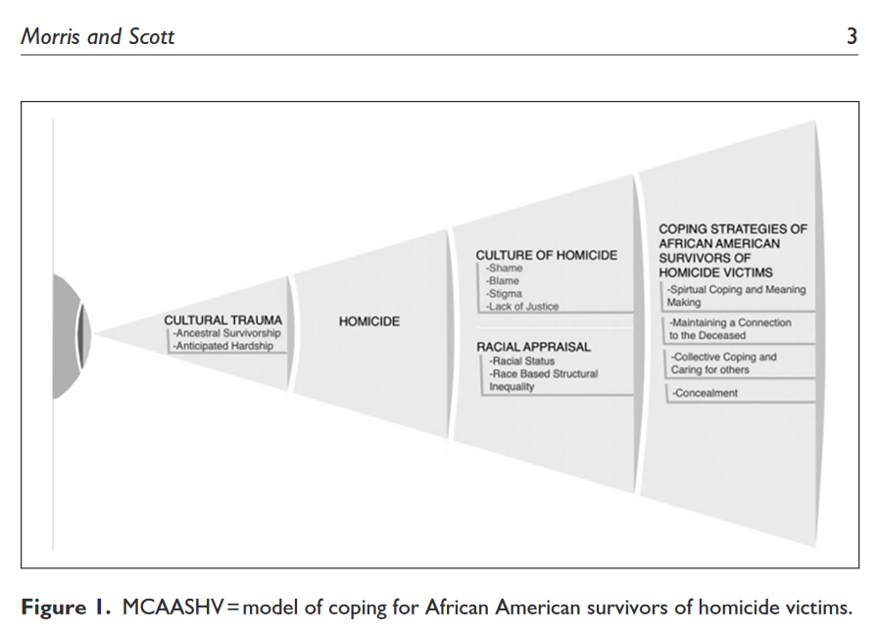
African-American experience of homicide in the US.

Slide 19

*all done!*

